Slide 1
Changing the Game:
Revolutionizing Leadership Development in Higher Education
Bryan C. Price, Ph.D.

Slide 2
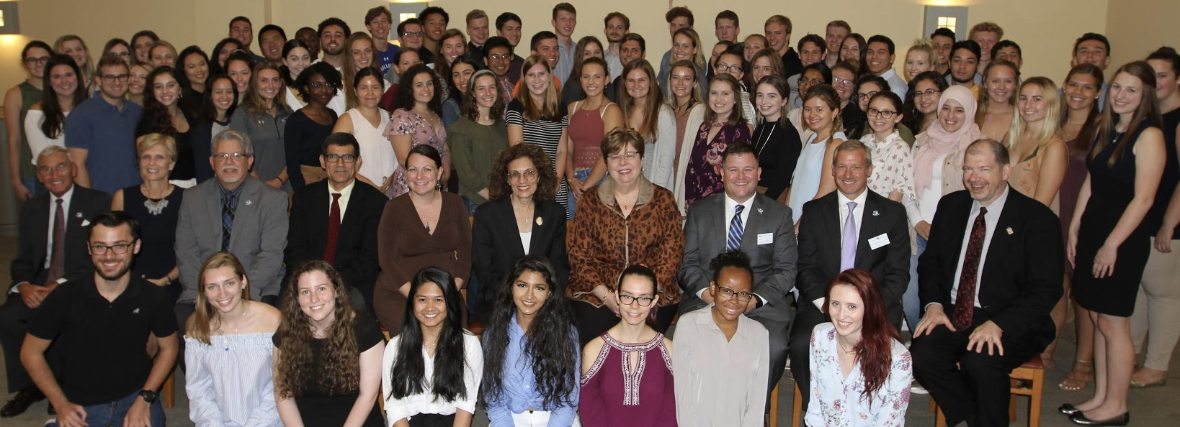
Thank you’s
Teaching Innovation Committee & MAACBA Board
Dr. Karen Boroff (former SHU Provost)
Dr. Mary Meehan (former SHU President)
Dean Joyce Strawser (Stillman School of Business)
Dr. Jerry Buccino
Students & faculty at Buccino Leadership Institute

Slide 3
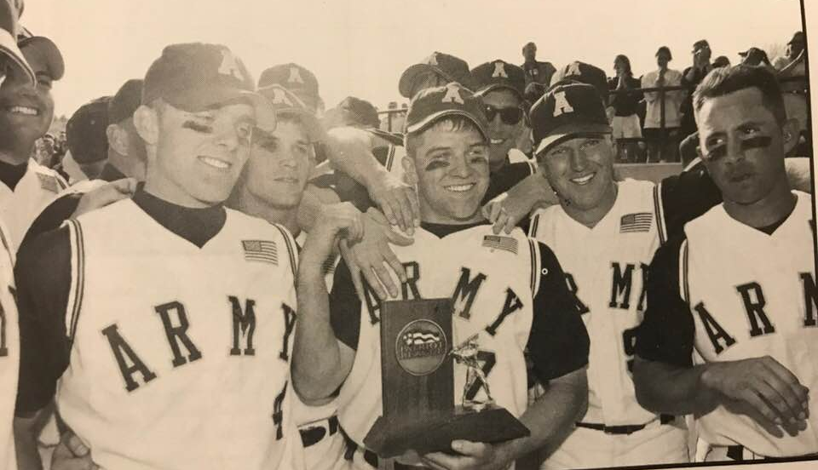
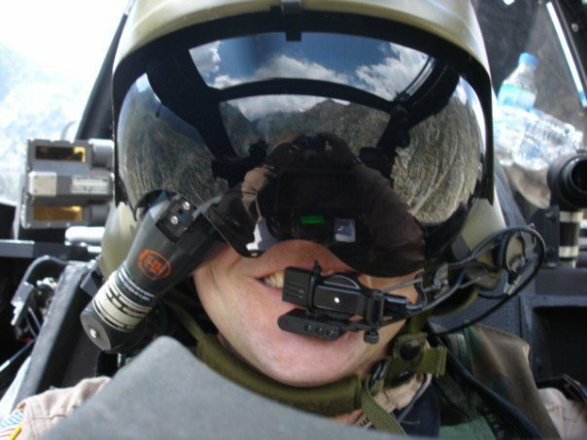
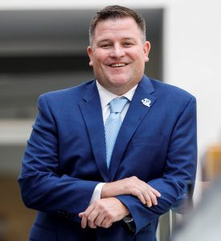
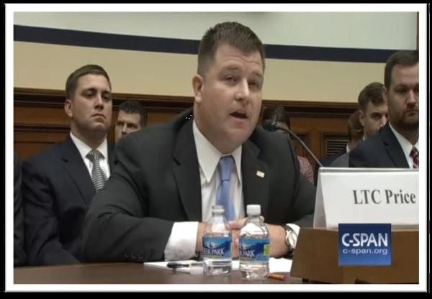
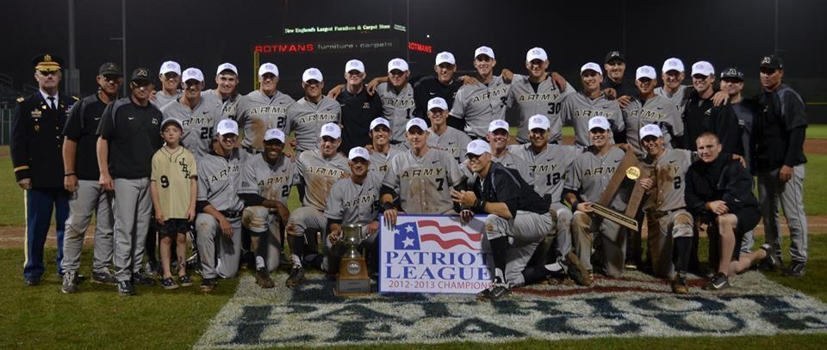
My Background

Slide 4
Buccino Leadership Institute
Created based on success of business leadership program dating back to 1995
Expanded university-wide in 2018
Comprehensive, 4-year, certificate-bearing program for competitively-selected students
275 students from 6 colleges/schools and 34 majors
Leadership class every semester (4 years)
Year 1: Lead Yourself - Year 3: Leading in My Profession
Year 2: Leading Others - Year 4: Leading in My Profession II

Slide 5
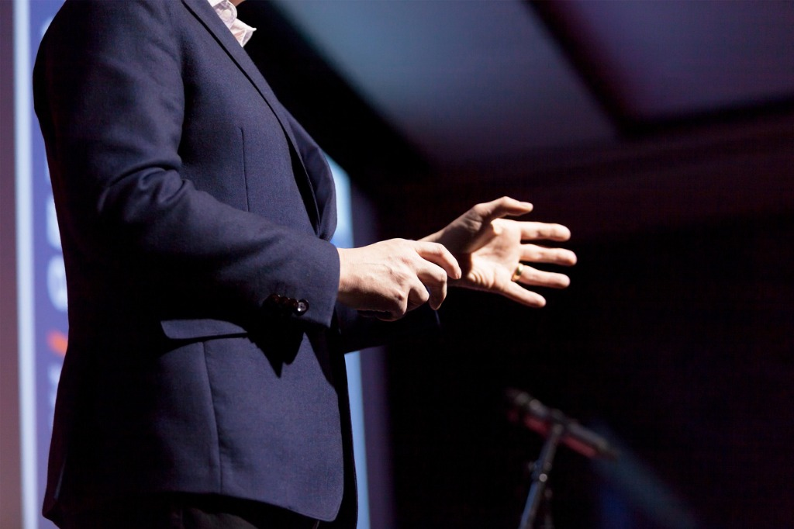
Unsatisfied with the status quo leadership development model
Step 2: Expect students to extract appropriate lessons & techniques
Step 1: Bring in someone to “talk” about leadership
Many (most?) leadership development programs rely on a model like this
Step 3: Expect students to apply those lessons & techniques on their own
?
Students rarely receive any feedback or reflect on their leadership effectiveness beyond the end results

Slide 6
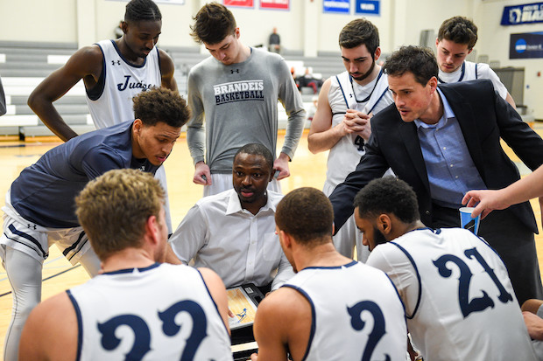
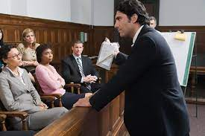
We don’t develop professionals like this in any other field…so why leadership?

Slide 7
Our Approach & Development Model
Leadership Model
Be: leadership is a mindset – you have to self-select into it
Learn: strengths, weaknesses, approaches
Do: leadership is a contact sport; you
have to practice it to get better at it
Reflect: feedback is a gift; the more, the
better, and from multiple sources
Repeat: you never “make it” as a leader;
you stop learning, you stop leading
Experiential
Feedback
Interdisciplinary

Slide 8
The Lead Up to LEAD 2050
Theme:
Leading Yourself
Lectures & Workshops
(Values, DEI,
Imposter
Syndrome)
Eq-i 2.0 Emotional Intelligence
LEAD 1000
LEAD 1050
Lectures &
Workshops
(Personal branding, talent management, giving feedback)
9/11
Field Trip
Interdisciplinary Team Projects
Theme:
Leading Others
Feedback:
Video
Peer
Faculty
DiSC
LEAD 2000
Gettysburg Field Trip
Leadership
Shark Tank*
Feedback:
Video
Peer
Faculty

Slide 9
Congrats, you’re an IDT “CEO” (1 of 4)
1
You successfully pitched a winning original idea in Nov/Dec for a Spring semester-long project…..
Before winter break, you are given every student’s…
2
Personal branding video DISC assessment IDT voting preferences

Slide 10
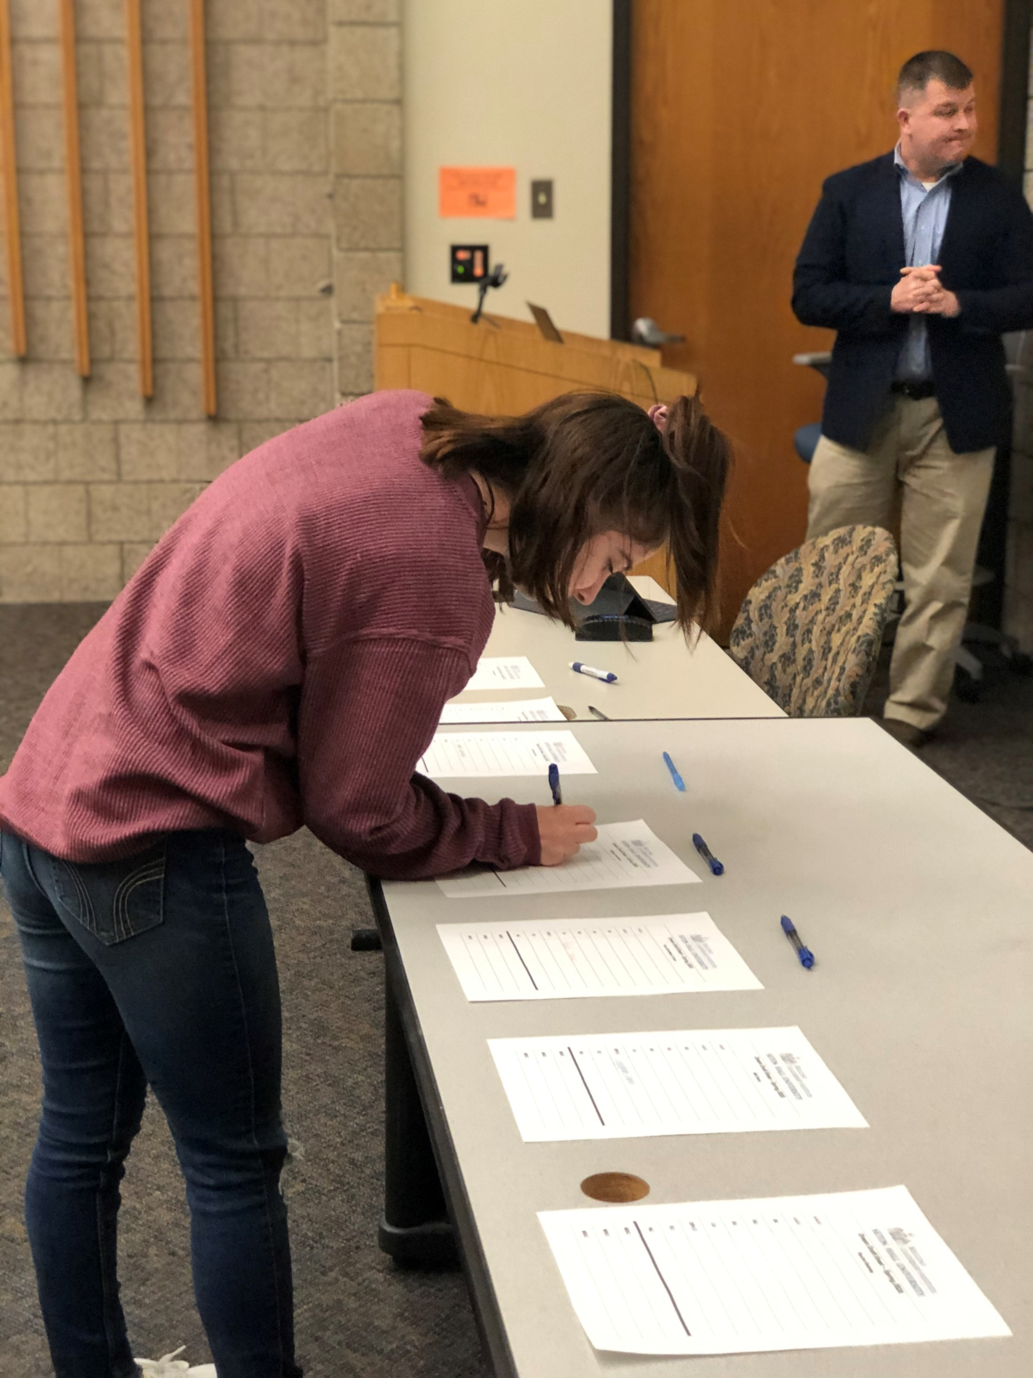
Congrats, you’re an IDT “CEO” (2 of 4)
During the 1st class of Spring semester, you have to “hire” your own interdisciplinary team in a live, fantasy football-like draft and discuss your methodology
3
Your 1st team meeting is recorded in an FBI-like interrogation room to evaluate how your run a meeting, articulate your vision, and delegate tasks
4

Slide 11
We turned Stillman’s Market Research Center, originally designed to execute focus groups for our marketing majors, into a leadership lab where students see and hear how they behave in real-world, boardroom settings.

Slide 12
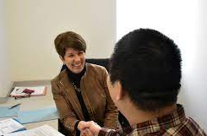
Congrats, you’re an IDT “CEO” (3 of 4)
Although you have 5 in-class sessions to meet with your team, you must coordinate times to meet outside of class to succeed.
5
You meet with your hand-picked professional ICF-certified leadership coach for 5 sessions to share challenges, navigate conflicts, and discuss courses of action.
6

Slide 13
Congrats, you’re an IDT “CEO” (4 of 4)
7
You win $1,600 at Seton Hall’s Pirate’s Pitch competition, represent SHU at NJ’s entrepreneurial competition, and are 1 of 100 teams to compete at a national competition.
8
Every student receives anonymous quantitative and qualitative feedback on their performance in an end-of-semester coaching session with their team’s faculty member.

Slide 14
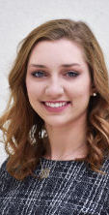
Success Stories
Annmarie Ryan (Sr, Nursing)
1st frosh IDT meeting: 3 words spoken
Credits seeing herself on video as turning point
Finishes semester as team’s MVP!
After working with leadership coach, decides to compete for Soph IDT CEO
Becomes IDT CEO, hires own team, improves SHU’s housing system, changes trajectory of her career

Slide 15
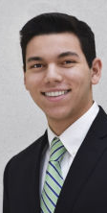
Success Stories
Dom Cirielli (Sr, Business)
Finishes 2nd to last on peer rankings during freshmen IDT
Works with leadership coach to improve over 8 months
Finishes as his Soph IDT’s MVP even though he was NOT the IDT CEO!
With newfound confidence, interned with AIG junior year and has already accepted job offer

Slide 16
Innovative aspects of program
Combination of:
real-world projects,
interdisciplinary teams,
professional coaching,
multiple sources of feedback
and industry-leading leadership assessments
…. is greater than the sum of its parts
Focus is on leadership development, not on how successful the IDT projects are
You never know what feedback will change the life of a student (peer, video, assessment, coaching, etc)
Incorporation of leadership coaching is a force multiplier

Slide 17
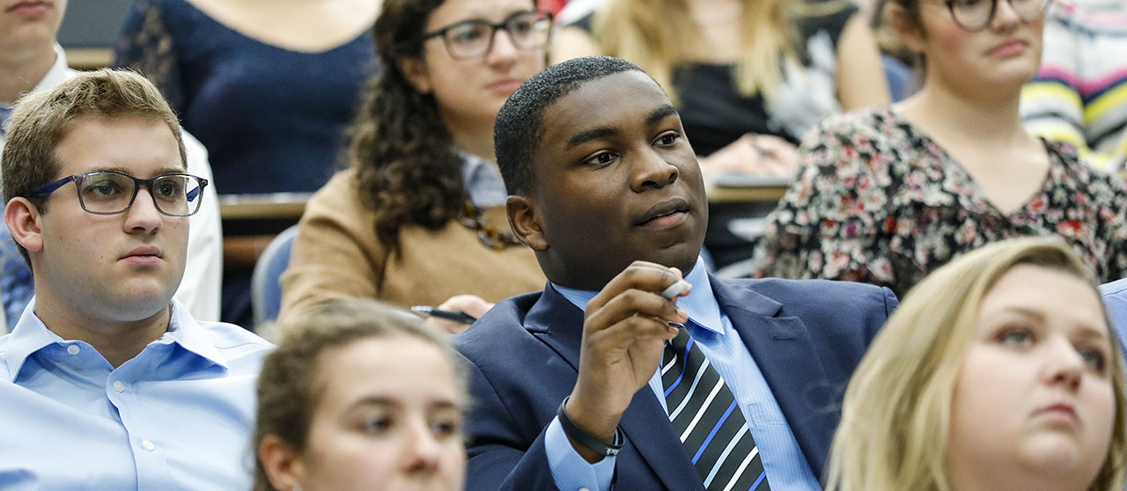
Thank you MAACBA!
“Tell me and I’ll forget.
Teach me and I may remember.
Involve me and I’ll learn.”
Xun Kuang

Slide 18
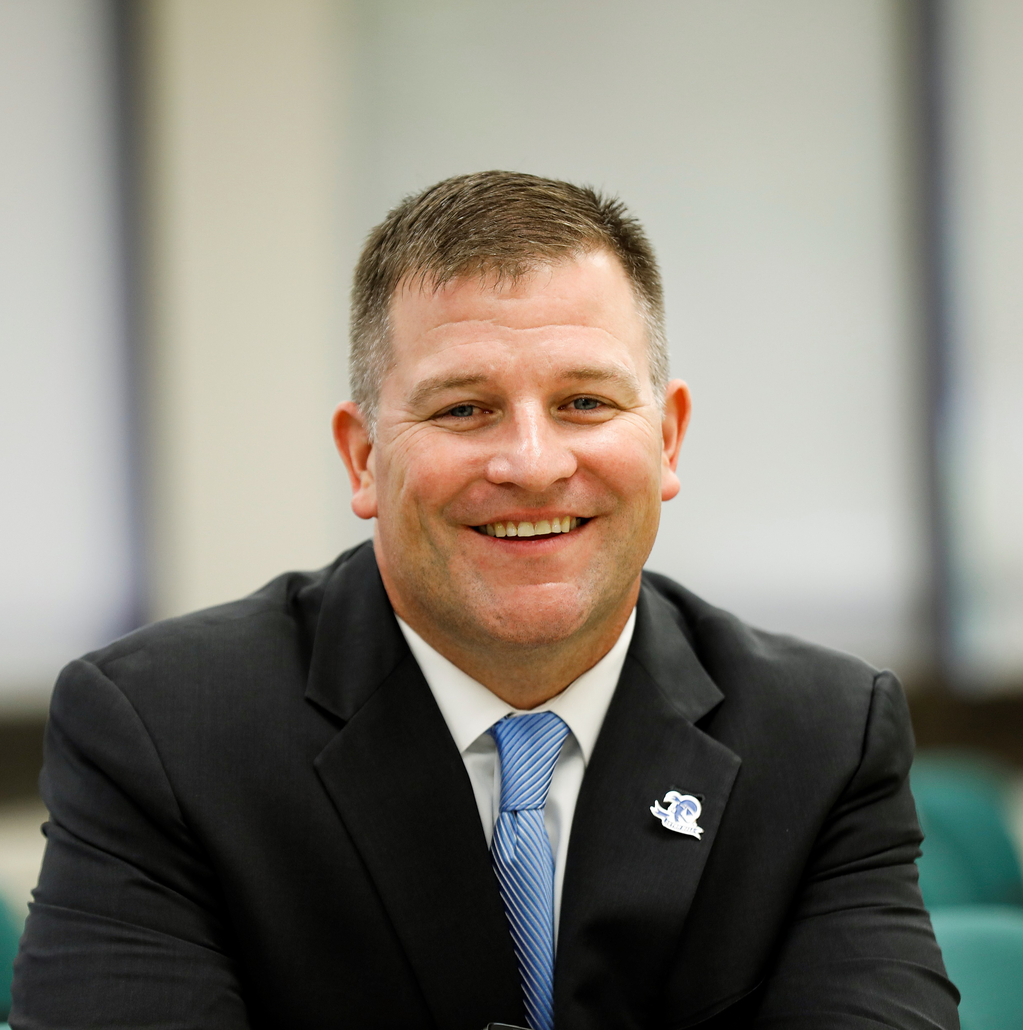
Connect with me
Bryan Price, Ph.D.
bryan.price@shu.edu
732-606-7326
www.shu.edu/leadership
@SHUleadership
@buccinoleaders
@Buccino Leadership Institute at Seton Hall

