Slide 1
Demonstrating Your B-School’s Impact to AACSB and Other Stakeholders
Middle Atlantic Association of Colleges of Business Administration
October 27, 2016

Slide 2
One day AACSB called…

Slide 3
“AACSB focuses on continuous quality improvement in management education through engagement, innovation, and impact.” 2013 Accreditation Standards

Slide 4
Where we started…
Pre-Forum B-School survey on impact
AACSB data on effective practices regarding mission
“Beyond Counting: Making an Impact with Intellectual Contributions” – Livingstone and Tang
Impact of Research: A Guide for Business Schools, AACSB publication
2013 Business Accreditation Standards, Appendix: Examples of Impact Metrics in Support of Documentation
Input from previous Impact Forums

Slide 5
Stakeholders Requiring Accountability
Stakeholders | Accountability Concerns
Accrediting Organizations (college- and campus-level) | Student learning outcomes Quality of offerings Impact of programming on stakeholders
Students/Parents/Alumni | Placement, career potential Earnings power
Business Community (Practice) | Student preparation for success Workforce diversity and pipeline Life-long training education Consulting and identification of best-practice solutions
Governing bodies (public and private) and media | Fiduciary responsibility Retention and graduation rates ROI (tuition, student debt, earnings potential)

Slide 6
Definition of Impact:
To have a strong effect; to cause change
Defined by the B-School mission
Assumes the change is positive, purposeful, and strategic

Slide 7
Differentiating Quality and Impact: A Research Example
Quality Indicators
Peer review process
Reputation of journal/outlet —ranking (e.g., “A” level)
Acceptance rate, other
Impact Indicators
External use and application;
to guide policy or practice
Faculty invitations to present,
train or consult
Citations – academic and
practitioner publications
Distribution and
engagement – attendance,
readership, circulation,
reprints, downloads, saves, etc.
Source- Livingstone and Tang, “Beyond Counting: Making an Impact with Intellectual Contributions”, ICAM 2014

Slide 8
Differentiating Inputs and Outcomes
Inputs ...such as
Student profiles and enrollment data
Programs, centers, and other initiatives
Finances and budgeting
Faculty credentials and productivity
Facilities and other resources
Outcomes.. such as
Student placement, career opportunities, accomplishments and advancement
Influence of faculty scholarship
on thought leadership in the discipline,
industry/practice,
public policy
society
Program benefits to campus, community, state, and country

Slide 9
Survey to AACSB Members on Impact
Launched Spring 2014
Sent to all member schools
530+ Responses
62 Countries participated
61% AACSB-accredited

Slide 10
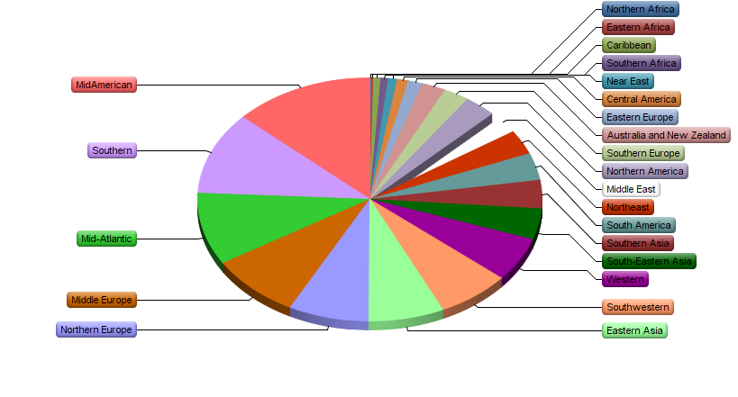
Impact Survey: Responses
62 Participating Countries

Slide 11
Survey Q5: Overall, how well do you feel your school’s actual impact aligns with its intended impact?
Avg. Response = 3.60/5.00

Slide 12
Survey Q6: In five years, do you anticipate that the relative importance of your school’s intended impact will change significantly?
Yes – 61% (314)
No – 39% (200)

Slide 13
Survey Q7: How do you think it will change? (most mentions)
Greater exec education, non-degree/certificate, and life-long learning
More partnerships, collaboration, and engagement
with industry, community, alumni
Stronger research focus
More applied research
More use of technology (blended programs, on-line)
More international/regional/local focus

Slide 14
What is going on at your school regarding impact and changing directions for impact?

Slide 15
Your Mission & Stakeholder Impact

Slide 16
Mission and Strategic Priorities
Culture
Decision Making and Resource Allocation

Slide 17
AACSB Guidelines for Research Impact*
Start with the mission, and be authentic – who are you in history, culture, marketplace, size/resources, SWOT
Define impact expectations at the school level, not the individual or unit level
Engage faculty (and stakeholders) in defining “impact”
Explore a range of measures
Communicate what was learned – internally and externally
* Summary from Impact of Research: A Guide for Business Schools http://www.aacsb.edu/~/media/AACSB/Publications/research-reports/impact-of-research-exploratory-study.ashx

Slide 18
Each B-School Should Identify:
The intended constituent group(s) or stakeholder groups for impact
The activities associated with each group
The intended outcomes on each relevant constituent group
Success metrics

Slide 19
Frameworks to describe what you impact: potential tools
What is your point of reference:
Activities
Stakeholders
How to represent impact
Radar or spider charts
Tables

Slide 20
Teaching
Research
Outreach
Service

Slide 21
Activity-Based Mission Impact Table
What we do | Who do we Impact | How | Potential Measure | Frequency
Teaching
Research
Service
Outreach

Slide 22
What the Mission States
Teaching
Research
….a rigorous grounding in the principles of business by bringing real-world perspective into the classroom.
Outreach
Service

Slide 23
Overlay Actual
Teaching
Research
….a rigorous grounding in the principles of business by bringing real-world perspective into the classroom.
Outreach
Service

Slide 24
Stakeholder-Based Impact Table
Stakeholder | Impacted by… | How | Potential Measure | Frequency
Students | Faculty member
 | Curriculum
 | etc.
University | BS mission
 | Research output
 | Quality of graduate
 | Programs
 | etc.
Business | Research output
 | Student projects
 | etc.
Society | SR projects
 | etc.

Slide 25
Industry
Board
Memberships
Community
Consulting
Service/
Outreach
Applied
Research
Speakers
Assn.
Leadership
Academic
Research
The Academy
Undergraduates
Study
Abroad
Journal
Editorships and
Review Boards

Slide 26
The Challenges of Demonstrating and Measuring Impact

Slide 27
Q14: Overall, to what extent do you believe your school effectively measures impact along important dimensions?
6% - Very effectively across dimensions
66% - Some dimensions more effectively than others
28% - Room to improve across most or all important dimensions

Slide 28
Survey Q8: Top Three Impact Metrics Heavily Relied Upon
Number of degrees granted
Research quality and quantity
Publications in specified journals (peer reviewed, “A”, highly ranked, etc.)
Number of citations
Student placement success

Slide 29
Survey Q9: Second Most Important Impact Metrics
Previous list plus…
Number of consulting projects and applied research
Rankings
Surveys/feedback from key stakeholder groups
Community engagement and student projects

Slide 30
Survey Q10: Third Most Important Impact Metrics
All of the others plus…
“Societal impact,” “social responsibility,” “policy impact”
“Effective learning,” AoL, “teaching impact’, “student performance in experiential opportunities,” “curriculum-based competence profiles”
“Alumni engagement”

Slide 31
Impact Measurement Challenges - Examples
Academic Research Impact
Teaching Impact
Community Impact
Ethics Impact
Social Impact
Interdisciplinary impact, partnering with other institutions
College “brand” perception by stakeholders
No. of new jobs, businesses, start-ups, innovations and entrepreneurship
Long term alumni success and engagement

Slide 32
Measurement/Demonstration Challenges
Timing
“Input Data”
Profiles on students and faculty
Resources
Programs
Facilities
Partnerships
“Near-Term Data”
Degrees and graduation stats
Placement data
Faculty publications
# of business projects
Alumni engagement
“Long-Term Data”
Publication citations
Alumni career success
Partnership success
ROI of new initiatives
Economic and business impact

Slide 33
Measurement/Demonstration Challenges
Data Availability
Secondary Data
College databases
Digital Measures
Sedona
Campus databases
Enrollment
Financial Aid
Career Services
Media rankings
Primary Data
Non-database data
AoL
Partnership information
Qualitative data
Student, employer, and alumni feedback
Brand and reputational perceptions

Slide 34
Measurement/Demonstration Challenges
Scope of Impact
“Discrete” Impact
Professional exam pass rates
Community/ Corporate engagements
Grants funded
Job Placements
“Stakeholder” Impact
Alumni, e.g., career advancement, leadership recognition
Practice, e.g., ROI, market share, process improvement, employee retention
Our Disciplines, e.g., thought leadership, graduate students’ career success
“Societal” Impact
Economic growth
Quality of life
Sustainability
Social responsibility

Slide 35
Example: Naval Post-Graduate School MBA
Scope of Impact
Creation of adopted military training modules
Leadership Impact
# grads promoted within military and govt. over time
Heads of military units and DOD who are alumni
Career opportunities beyond the military
Societal/Social Impact
Military/DOD efficiency, effectiveness, and innovation

Slide 36
Recommendations
Start with the low hanging fruit
Input and near-term data
Secondary data
Narrow scope
Phase in difficult measures over time
Choice of high cost measures should be tied to…
mission and strategic priorities
measurement systems that are sustainable
Dashboards, not overly complex
Processes and systems that are easy to manage over time (avoid complexity)

Slide 37
Creating Your Impact Narrative – Telling Your Story
Quantitative Metrics
Qualitative Evidence

Slide 38
Communicating Impact

Slide 39
Communication Targets
Internal
Creating culture
External
Recruiting students and faculty
Media
AACSB
Exec. Summary
Each of the Standards
Business/Industry
Alumni and Donors
Rewards and incentives
Impact Metrics
and Evidence

Slide 40
Discussion

