Slide 1
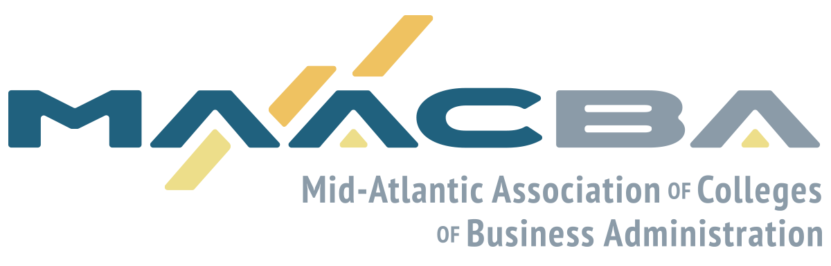
1:45 pm - 2:45 pm
MBA Directors Panel
Sharon Lydon, MAACBA Graduate Representative, and Associate Dean at Rutgers Business School

Slide 2
Did Covid Kill Testing in MBA Admissions?
Sharon Lydon, Associate Dean, Rutgers Business School
Katherine Henderson, Business School Strategic Advisor Eastern & Midwestern USA, ETS
Eric Chambers, Market Development Director, Americas, GMAC
Erin K. O’Brien, Assistant Dean, Chief Enrollment and Marketing Office, School of Management, University at Buffalo, The State University of New York (SUNY)
Dr. Randy L. Frye, Founding Dean, Shields School of Business, and Professor of Business Administration at Saint Francis University

Slide 3
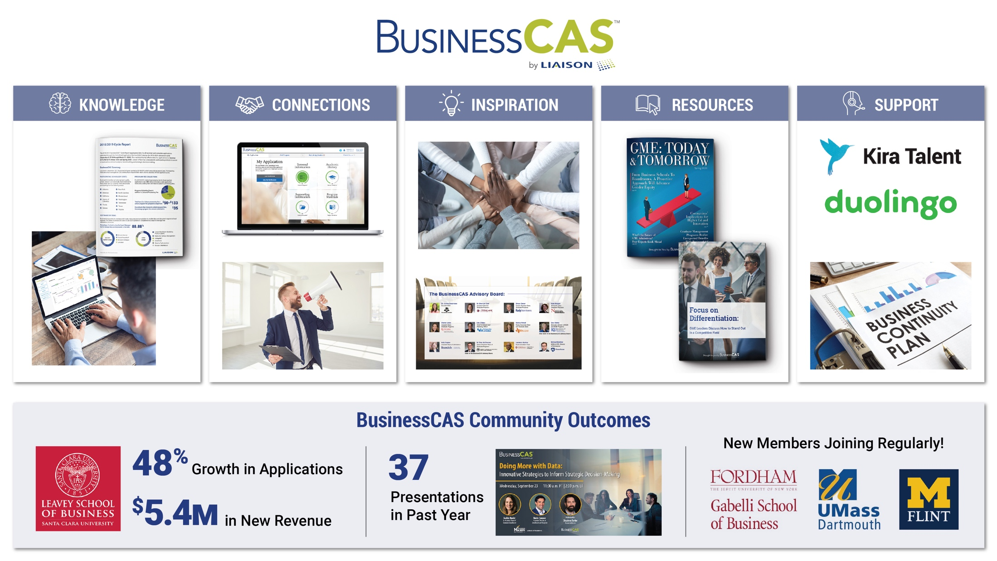

Slide 4






ETS FACTS
Katherine Henderson
Business School Strategic Advisor Eastern & Midwestern USA
Develops, administers and scores 50 million tests annually in more than 180 countries
ETS is a nonprofit, 501(c)(3) organization
75 years of experience in educational research and assessment
Mission: to help advance quality and equity in education
Significant annual investment in researching solutions to educational challenges
Notes:
ETS is a nonprofit organization that values social responsibility, equity, opportunity and quality.
We are the world’s largest private educational assessment and research organization.
While many people focus on ETS’s assessment brands, educational research and innovation are also a core part of ETS’s business.
The organization’s mission for 70 years has been to help advance quality and equity in education.
And, toward that end, we make significant research investments in finding solutions to big educational challenges. One of those big 9 challenges is increasing the diversity and quality of admission to higher education, inclusive of law schools.

Slide 5

Taking the GRE® General Test from the safety of home
Just six weeks after the coronavirus began shuttering test centers in Asia, ETS launched the GRE General Test at home so students could continue their educational journeys without delay.
The GRE General Test at home is:
  Identical in content, format and on-screen experience to the usual testing experience
  Offered at the same price
  Accessible, with extended time, extra breaks, screen magnification, selectable colors and other accommodations available
  Monitored and recorded through use of live human proctors and artificial intelligence technology through ProctorU®.
To date, more than 185,000 students from 157 countries have registered to take the at home test.
Notes:
Just six weeks after the coronavirus began shuttering test centers in Asia, ETS launched the GRE General Test at home so students could continue their educational journeys without delay … and without sacrificing their safety.
Identical in content, format and on-screen experience to the usual testing experience, so that students wouldn’t need to change how they are studying for the test, and admissions committees wouldn’t need to deal with changes in score scales or other barriers to their usual process
Offered at the same price; ETS is not passing along the cost of the remote proctoring services to students
Accessible, with extended time, extra breaks, screen magnification, selectable colors and many other accommodations available

Slide 6
The case for using GRE® scores
Every component of a student’s application is subject to bias.
GRE scores help mitigate that bias. They:
  Offer common, objective measures that help to level the playing field
  Provide evidence of academic skills and graduate readiness
  Balance the limitations of any one part of the application when used as part of a holistic admission process
The GRE scores are the ONLY part of the admissions file that regularly go through rigorous fairness reviews and yield comparative data.
Without GRE scores as a normalizing factor, what other measure will programs use that is common and objective, undergoes a rigorous fairness review process and yields comparative data?
Future Measurements- Soft Skills Assessments
Notes:
The benefits of having a standard measure that helps to level the playing field and provides evidence of academic skills and graduate readiness outweigh the limitations of the tests, which can be overcome by adopting a holistic admission process that balances the limitations of any one part of the application. Resource: Reviewer Diligence and Responsibility in the Graduate Admissions Process
Every component of a student’s application is subject to bias. For example, a committee could be influenced by the status or eloquence of the person who wrote a recommendation letter. Or the reputation of the undergraduate institution. Or that an applicant had less available time to do research or take unpaid internships due to the need to work. Resource: Gradeinflation.com
The GRE tests are the only part of the admissions file that regularly go through rigorous fairness reviews. They are overseen by the GRE Board and GRE Technical Advisory Committee (a group of external psychometric experts), and meet psychometric standards published by the American Psychological Association (APA), the American Educational Research Association (AERA), and the National Council on Measurement in Education (NCME). Resource: Test Fairness and Validity
Without GRE scores as a normalizing factor, what other measure will programs use that is common and objective, undergoes a rigorous fairness review process and yields comparative data? How will applicants be fairly compared, especially those from underrepresented groups and other countries?

Slide 7
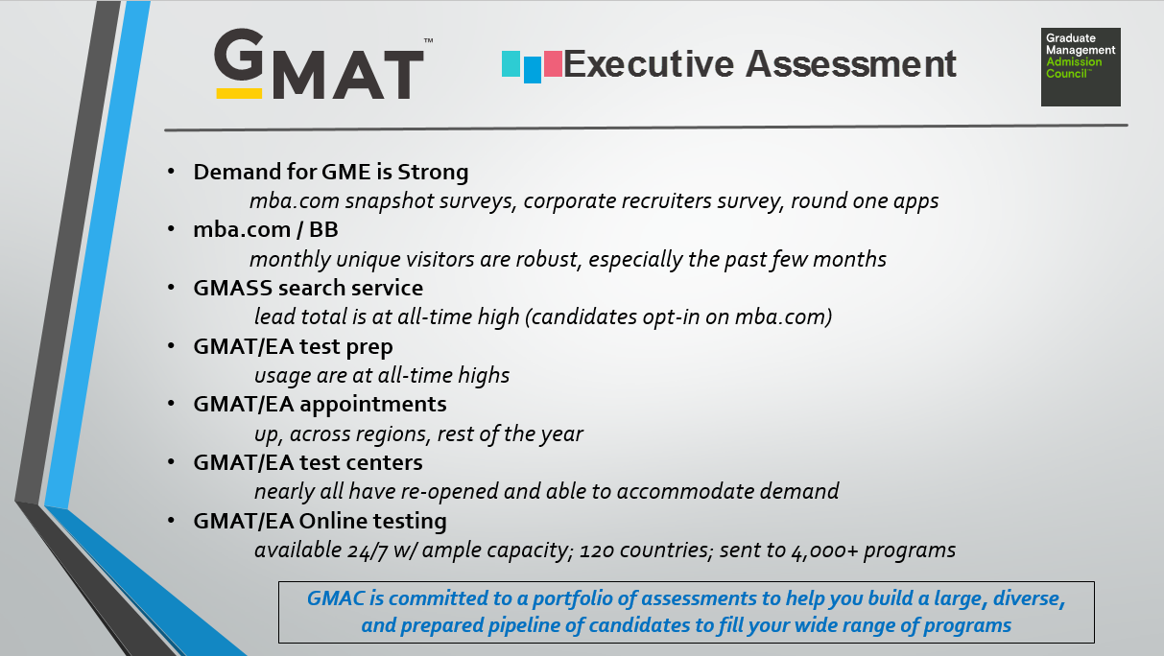
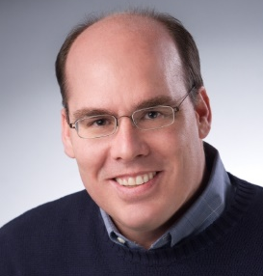
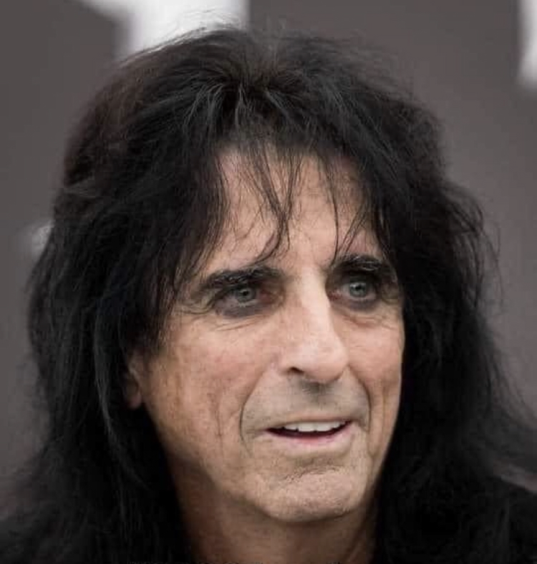
2020
Dramatic, Unpleasant, and WAY too long!
WOULD NOT RECOMMEND

Slide 8
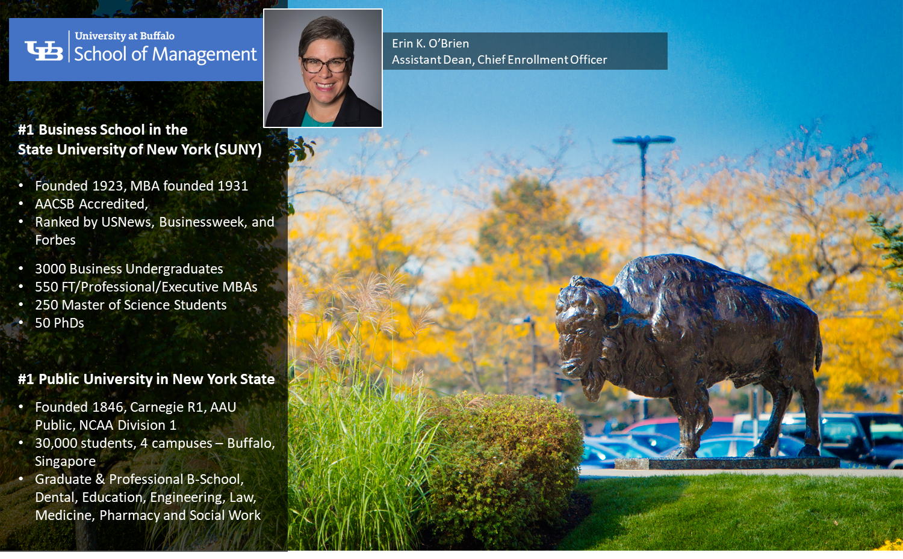

Slide 9




Pre-COVID
COVID Accommodations
GMAT/GRE Waivers – GPA, Work Experience, UG Majors
Alternative credentialing pathways
Conditional Admission
EMBA, PMBA, Masters of Science test waivers
Barrier-free entry pathways for our own students
Currently
Lessons and Insight
Continued pre-COVID barrier-free pathways
Extension of COVID Accommodations into 2021
Early Intervention Support
Academic Performance Tracking
Enrolled a Fall 2020 cohort
Increased URM Diversity over 100%
Exclusivity vs. Access
Assessing Essentials Skills instead of Testing?
Rankings?

Slide 10



Shields School of Business at a Glance
10 Undergraduate Programs - 480 Students (2,300)
2 Graduate Programs - 81 MBA Students (479)
Centers:
SBDC – est. 1979
Knee Family CSOR – est. 2016
Francis in the Marketplace Executive Training Center – est. 2016
Red Flash Division I Athletics
Randy L. Frye
Dean, Shields School of Business and
Professor of Business Administration

Slide 11
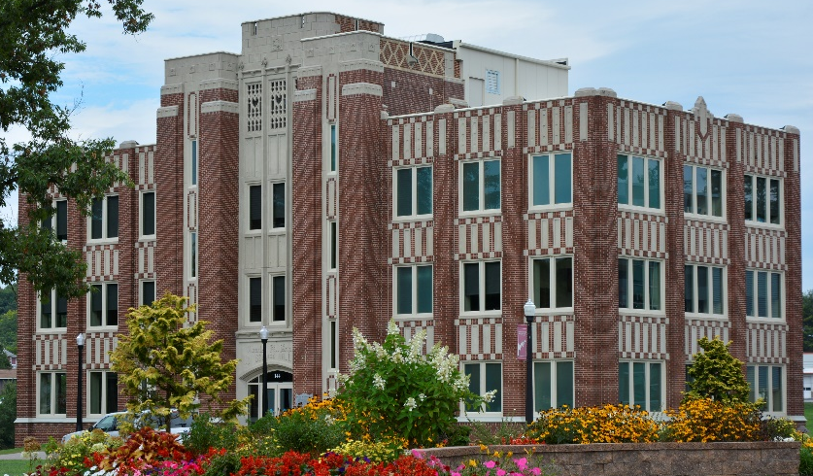

Saint Francis University MBA Program (Circa 1990)
A. Core Market Thrust Segments
B. Needs to be Satisfied
Career access
Influence – increased impact at work
Opportunity for Growth & Development
Career advancement
Career pivoting
Self-esteem
“Balanced Careerist”
I want to advance, but school cannot disrupt my life.
“Career Revitalizer”
I need to take my career to the next level to be successful.
“Respect Seeker”
A graduate business degree will give me the status and respect that I crave.
“Socio-economic Climber”
I want to achieve everything my parents could only dream of.
SOURCE: GMAC Global GME Segmentation Study

Slide 12
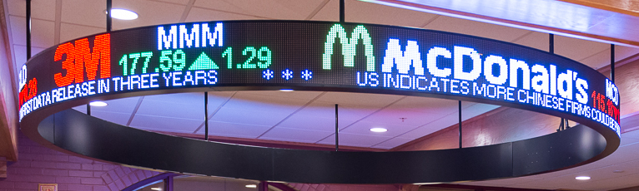
What are desired program attributes and “purchase” criteria?
Price and economy
Perceived value and reputation
Convenience and access
High customer service – friendly and customer-centric
Lifestyle fit for working professionals
Low barriers of entry/reduce or eliminate “points of friction”
Realistic completion on a desired timeline
GMAT Analysis for Medium to Small MBA Programs
+ Valid predictor of success for high performers
+ Tests are commonly used selection measures in American institutions
Delay or create an Admissions Bar for many – “points of friction”
Equally valid predictors o success are available that cause less stress and strain on prospects
Culturally biased? Some people do not “test well” but do well in our graduate programs
Student-centric, more personalized approach (customer intimacy model)
Form barriers to achieving desired enrollment targets

Slide 13
Thank you! Q&A

